Slide 1

BLRBAC Vancouver Nov 15-2023 Aircheck
Gus Vergel
Industrial Applications and Clean Air Advisor
g.vergel@bgecleanair.com

Slide 2

Gas-Phase Filtration Solutions
Agenda:
  Equipment to protect
  Cost of a Board
  Microscopic Corrosion
  Metals to protect
  Current Situation:
    Identify
    Quantify
    Analyze
  Corrosion Aids
    Indicators or Monitors?
    Specialty HVAC
    Media Longevity
    Equipment

Slide 3
Equipment to Protect
VFD’s, PLC’s, DCS IO Boards, Field Instruments, Integrated Circuit Boards ICB’s, Printed Circuit Boards PCB’s, Servers, Magnetic Recording Media, Switches, Relays, Contacts, etc.
5 Dollar Fuse Story!!!!!

Slide 4
Protect your equipment from…….?
Moisture
Corrosive Gases
Oxygen
Particulate

Slide 5

Cost of a Board
We all have dealt with electronic board failures from our house to our vehicles.
Boards are on the range of 2K to 20-30K.
Downtime
Production Losses
Nowadays the cost of a board could be considered priceless if we are Careless.

Slide 6
Microscopic Corrosion
< 0.03 micron per year.
Gas Phase Filtration is the most effective and practical method to remove or reduce the concentration of Corrosive gases.

Slide 7
Metals to protect
The passage of lead-free (RoHS) Restriction of Hazardous Substances in Electrical and Electronic Equipment manufacturing regulations for all electronic equipment has placed a greater emphasis on the control of corrosive gases.
Lead-free products with a silver surface finish will corrode in high sulfur environments.
Silver
Gold
Copper

Slide 8

Current Situation. From Consequence to Cause!
Identify all electronic boards replaced over the last 2-3 years.
Quantify the (Cost, labour, downtime)
Analyze each defective board based on the following:
  Location : (Bleach Plant, Control Room, etc.)
  Sub-location: (MCC, Control Room, Data Center, etc.)
  State of “Control Room” (AIRCHECK)
    Doors, ceiling, roof, conduit cables sealed.
    Airlocks state
    Air Conditioning Maintains 20-21C / 70F
    Humidity : 42 % RH
    Is the AHU/Scrubber working properly, maintained and equipped with the adequate media and filters?

Slide 9
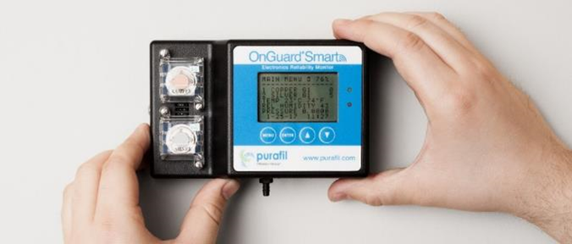
Corrosion Aids
Indicators or Monitors?
  Reactivity Monitoring Coupons: This passive method is an indicator of corrosion that uses a pre-measured and weighted piece of silver or copper to be exposed in the corrosive environment.
  Active Monitoring System: This method is and electronic device that involves constant feedback of data measuring the type and level of corrosion, temperature, humidity, and room pressure.

Slide 10
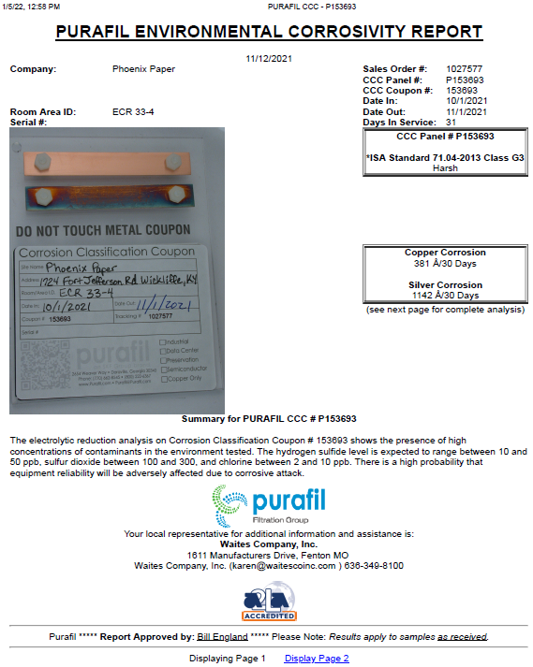
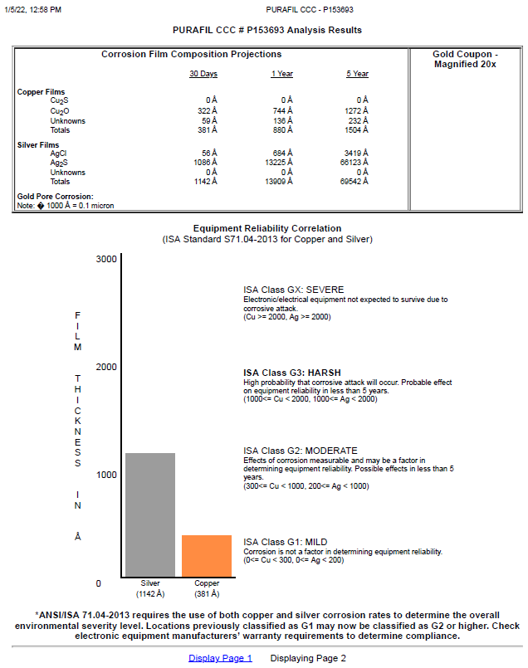
Rep Name
Address
Contact info

Slide 11
Specialty HVAC
AHU and/or Scrubbers?
  The combination of Both
  Sequence:
    Screen
    Demister (Droplet separators)
    Prefilter MERV 8, 9
    Media
    Post Filter MERV 13, 15
MERV: Minimum Efficiency Report Value

Slide 12
Media Longevity

Slide 13
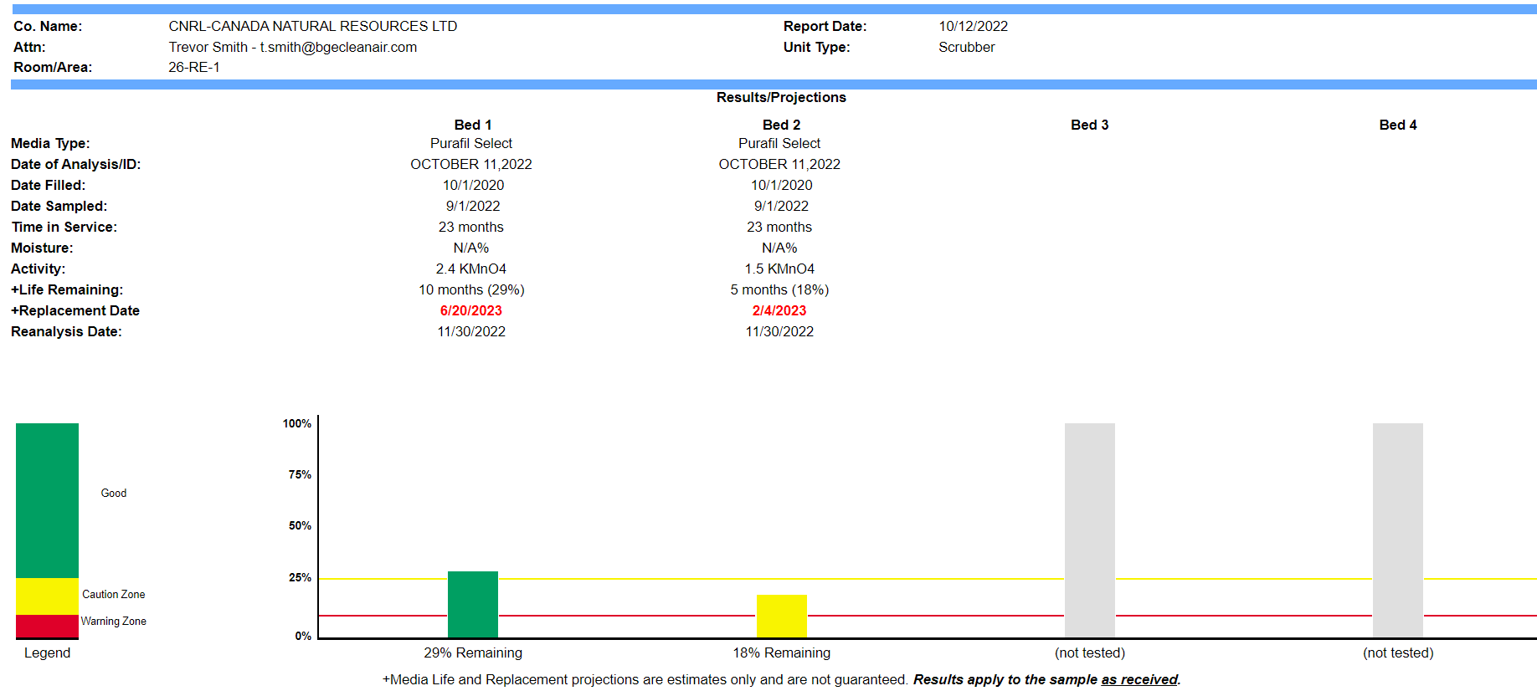

Slide 14
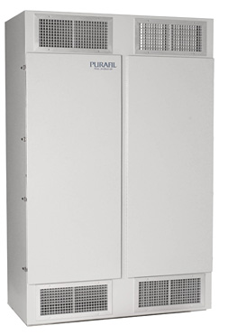
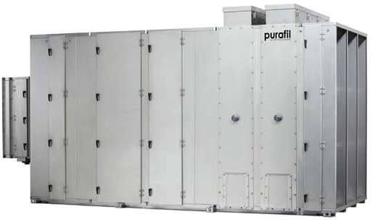
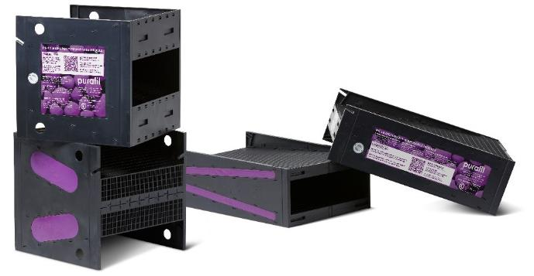
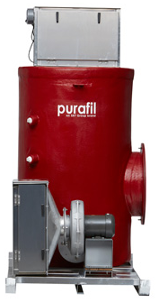
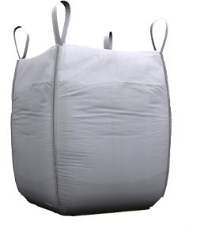

Media and Equipment
Modules Easy to replace molecular media cassettes with sampling ports, and our patented Posi-Track™ technology.
Bulk Media
Media available in 36x37x48 poly lined sling bags or 1ft³ corrugate boxes for bulk applications.

Slide 15


BGE Over 50 Years Providing Indoor Air Quality to all Industries.

