Slide 2
Do not add text here
Lisa Mansson
Global Manager – Online Learning
Gothenburg, Sweden
Tom Jurista
Boiler Engineer
Kamloops, BC, Canada
Do not add text here

Slide 3
Valmet Learning Services
Training tools and methods to reach your targets

Slide 4
Do not add text here
What is training?
Do not add text here

Slide 5
Do not add text here
train·ing
“The action of teaching a person or an animal a particular skill or type of behavior.”
Do not add text here

Slide 6
Our past training experiences
Childhood
Youth
Adulthood

Slide 7
Do not add text here
job train·ing
“The process of increasing the knowledge and skills of an employee for doing a particular job.”
Do not add text here

Slide 8
HOW IS ON THE JOB TRAINING TYPICALLY COMPLETED?
Peer to Peer (usually for a multiple of several shifts)
Show and tell with hardcopy of training check sheets for an applicable topic or job.
Completing or developing sketches of applicable systems.
Review of training results upon completion by a Supervisor, Manager or Team Leader.
Signed off as “trained” and ready to work solo on the job.
Notes:
These are two cases where training have had a significant impact on the customers’ KPI’s. The cases are fictive but based on data from real projects.

Slide 9
Do not add text here
Why is all this important?
Do not add text here

Slide 10
”If You Always Do What You’ve Always Done, You’ll Always Get What You’ve Always Got.” Henry Ford

Slide 11
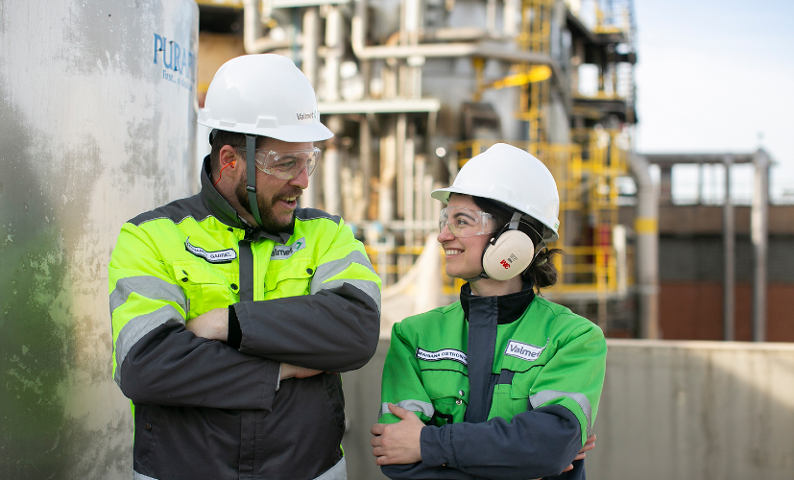
Grey tsunami
Work force Culture shift – Actually Generational
Loss of practical experience in industries
Life work balance importance has and is changing
Mobile App generation
PARDIGM SHIFT

Slide 12
Adult Learning Theory
Valmet training concept is designed to meet these principles
Adult Learning Theory offers a solid base of principles for How and Why to Learn as an adult
Readiness to Learn Adults who are ready to learn are usually spurred by a specific reason, such as self-development and growth related to their work or career path.
Orientation of Learning Adults are more prone to learning when it is applicable to Everyday lives instead of general learning about certain subjects that are unrelated to our lives. In general, adults will want to learn practical skills that will make their lives and work more efficient.
Motivation to Learn Adults require their own motivations and reasons to learn new things. As children, the reason for learning is simply because they are directed to learn; however, adults need to develop their own motivation.
Reason to Learn Adults require a strong reason to learn, such as a problem that they need to solve and an immediate application of new knowledge.
Self–concept Adults’ learning is much more self-directed and independent as they mature. It allows adults to decide when they want to learn, what they want to learn, and how they want to learn. Such an assumption shows that educators need to develop a plethora of choices for adult learners, allowing them to design their own learning environment.
Experience Adult learning, in contrast to children, includes a significant amount of previous life experiences to rely upon to assist with new learning experiences. The previous experiences can bring a unique perspective that fosters discussions and are valuable learning resources.
Readiness to Learn
Orientation of Learning
Motivation to Learn
Reason to Learn
Self–concept
Experience
Adult
Learning
Theory
American adult educator Malcolm Knowles initially developed the adult learning theory in 1968, with six key points or assumptions.

Slide 13
Do not add text here
meth·od·ol·o·gy
“A system of methods used in a particular area of study or activity”
Do not add text here

Slide 14
Learning methodology
Blended learning approach for adults
Classroom instructor-led
Web-based self-paced
Simulations & scenarios
Hands-on equipment
Offline
Theoretical
Mockups
& demos
Online
classroom
BLENDED LEARNING
Integrated simulations
Online
simulations
Practical
Online

Slide 15
Do not add text here
Inve$tment in technology ha$ been far ahead of Investment$ in training methodologies
Do not add text here

Slide 16
Recovery Boiler Technology Improvements
The last 50 years of development… Only a snaphot
Computers and PLC systems
DCS systems instead of strip charts
The ability to trend many items in time via historian packages such as PI or Parcview
Advancements in metallurgy with composite tubes
Advancements in NDE methods and inspections based on risk - RBI
Mini Hoods for smelt spouts
Robotic spout cleaning
APC (Auto Port Cleaners) systems
Cleanability improvements by advanced controls and blower designs
Bed and thermal imaging cameras
Reliability systems and programs
Safety systems – Fire Resistant PPE
Liquor Cycle control improvements with continuous testing by analyzers and tracking with predictive modeling to stay close to spec with minimal variation
Environmental control advancements such as NCG control with incineration and zero effluent systems
CFD (computational fluid dynamics) modelling used for designing air systems and tuning of recovery boilers.
Ergonomical design considerations for operators

Slide 17
Lack of training leads to performance degradation over time
With Good training, you keep knowledge over time
Degradation time
Refresher training
Start-up training with Valmet
Faster start-up = gained profitability
Lost profitability
System profitability
Commissioning and Startup after a Shutdown
Time

Slide 18
When do we learn the most?
Find the motivator for your personnel
Interest and collaboration
Everyday development
Push yourself to new views

Slide 19
Drivers for better trained personnel
What is mostly causing an unplanned stop, lack of competency or failure in the systems, or a combination that leads to unstable operation?
Well trained personnel can give
Operate to minimize plugging of heating surfaces, causing unplanned stop and decreased of energy production
Longer operation periods – calls for simulator training of shutdown and startup procedures
Shortened start-up periods after shutdown
Increase availability & reduce unplanned shutdowns
Decrease maintenance & service cost
Maintain production levels
Avoid safety hazards
Motivated operators
Unified operations between shifts / Common strategy of operation
And – A more common understanding how to operate the boiler will lead to a stable operation and only then, you will be able to fine tune and control the operations more efficiently
What do you gain with good training package

Slide 20
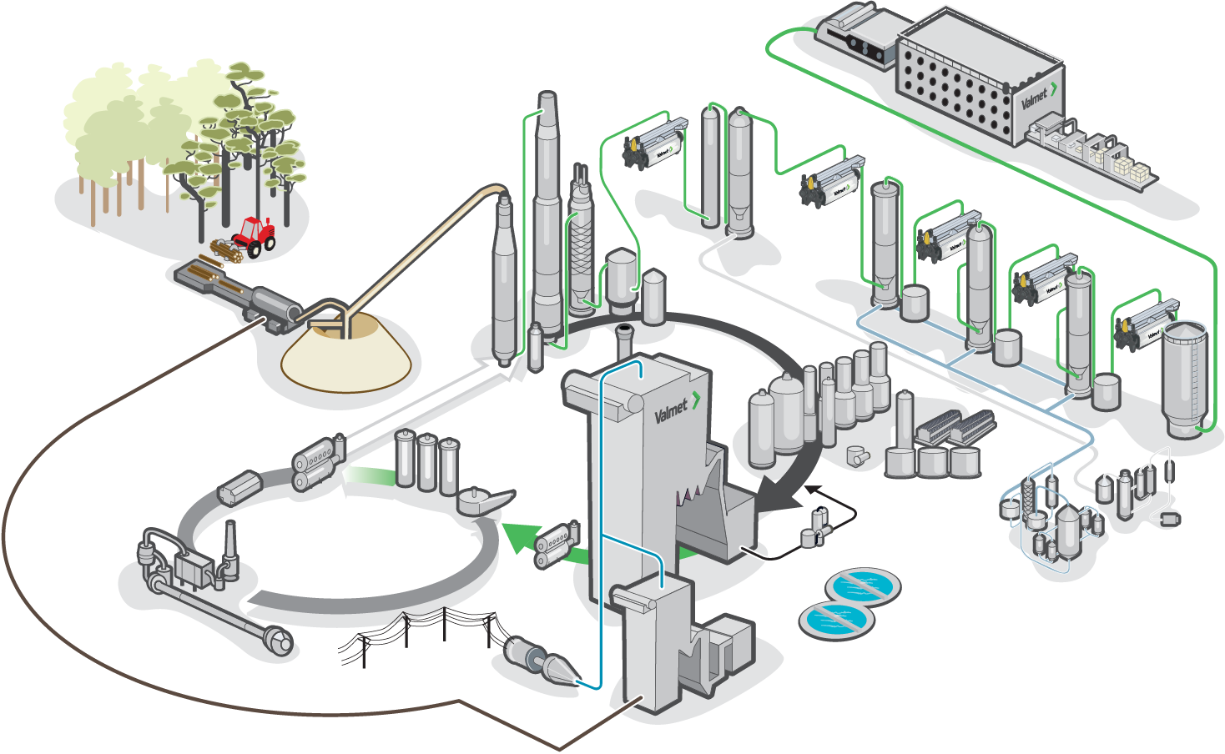
Valmet Learning Services – Training available for the whole Pulp mill

Slide 21
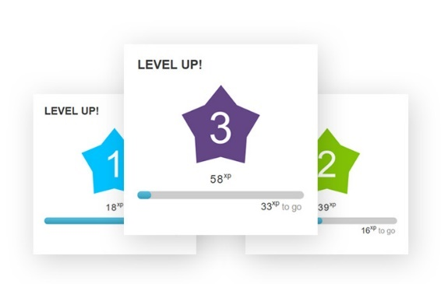
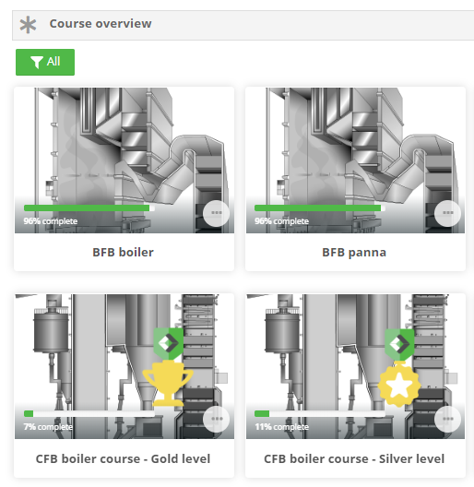
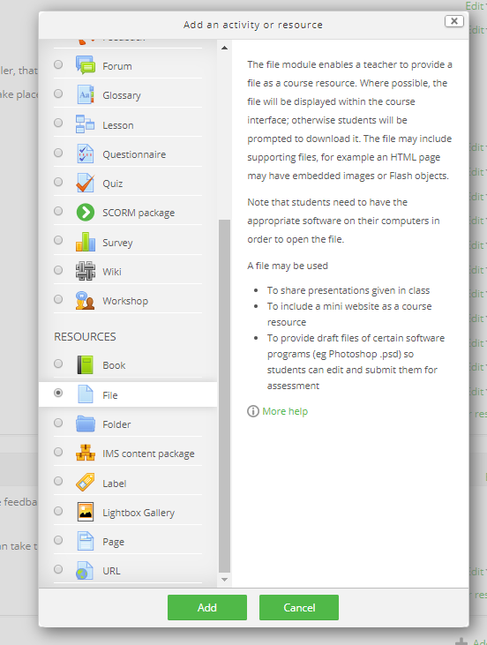
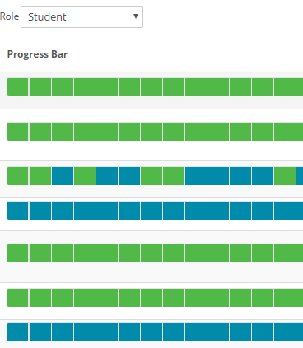
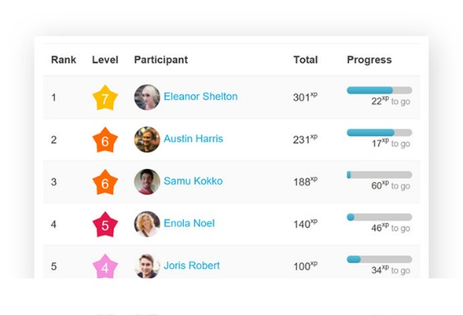
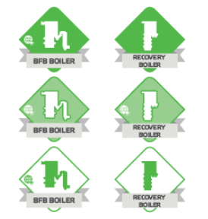
Valmet Online Learning
24h access & No installation
Student role:
Student dashboard
Courses & Quizzes, Badges
Manager role:
Tools for reporting and creation of content

Slide 22
Course development
Competence and engagement forms In-depth and professional courses
All courses are thoroughly planned, developed and reviewed by all the necessary representatives, such as script writers, subject matter experts, language expert and media developers.
Course planning
Service engineers
Media makers
Script writer
Development
Process engineers
Project manager
Translations
Pilot customers
Culture transitions

Slide 23
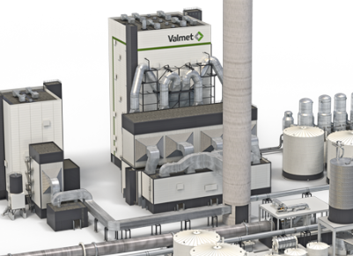
Recovery boiler training
Learning path in several steps
1
2
3
4
5
RB Competence mapping
RB Systems & processes
RB safety course
MyPlant page
Simulator training
Self-assessment
Knowledge test
Gives understanding of the design and function of the Recovery boiler
Learn about risks and preventive security actions in Recovery boilers
In cooperation with customer and Valmet – Training material with customized content
Tailormade or Reference simulator in cloud or on computer stations
Classroom days with Valmet expert at training start
RB Competence mapping

Slide 24
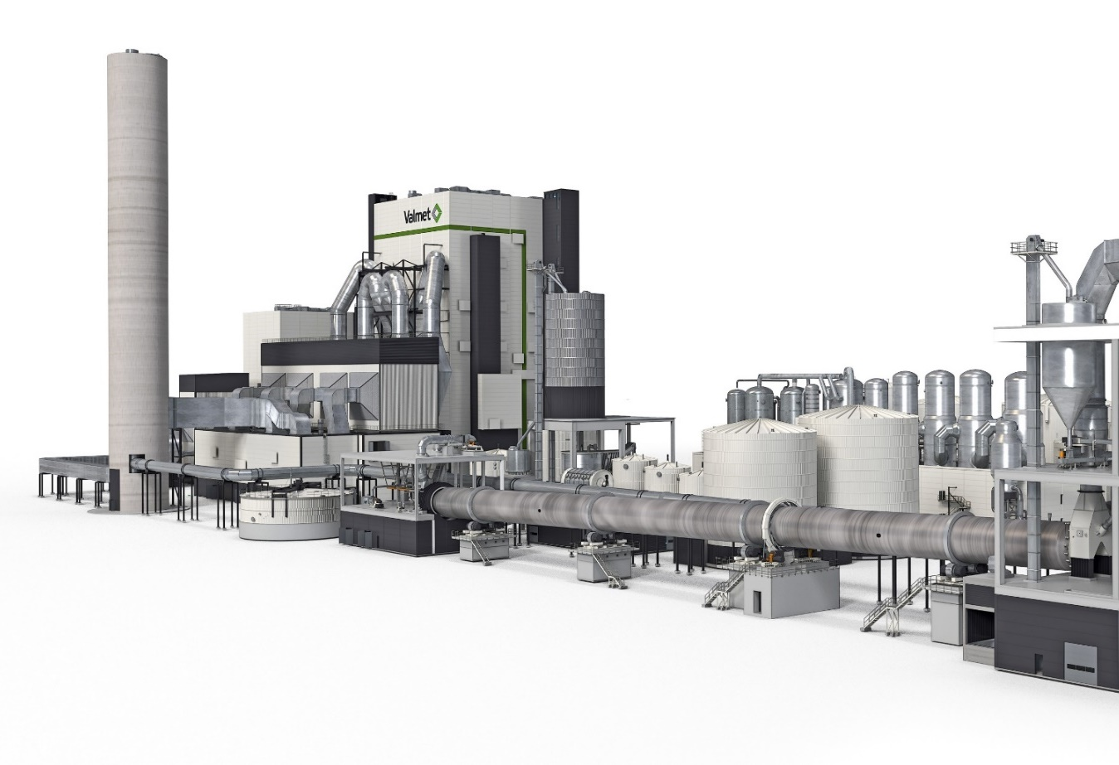
Competence mapping - Self estimation
Most of the categories are within 3. Good level of understanding
20 submitted answers
Notes:
0 = Little or no knowledge
1 = Has a basic awareness
2 = Is able to detect and correct deviations. Can work independently with help of support
3 = Has a good level of understanding and can work independently
4 = Has a high level of understanding. Can optimize and troubleshoot

Slide 25
Results in comparison Quiz 1 & Quiz 2
Pulp mill All groups
Correct answers 63% average
Correct answers increased to 83% average
RB courses
The results range from 50-85% correct answers
The results range from 70-95% correct answers
17 Participants
7 Participants
Notes:
Result From average 63% to 83% correct answers.

Slide 26
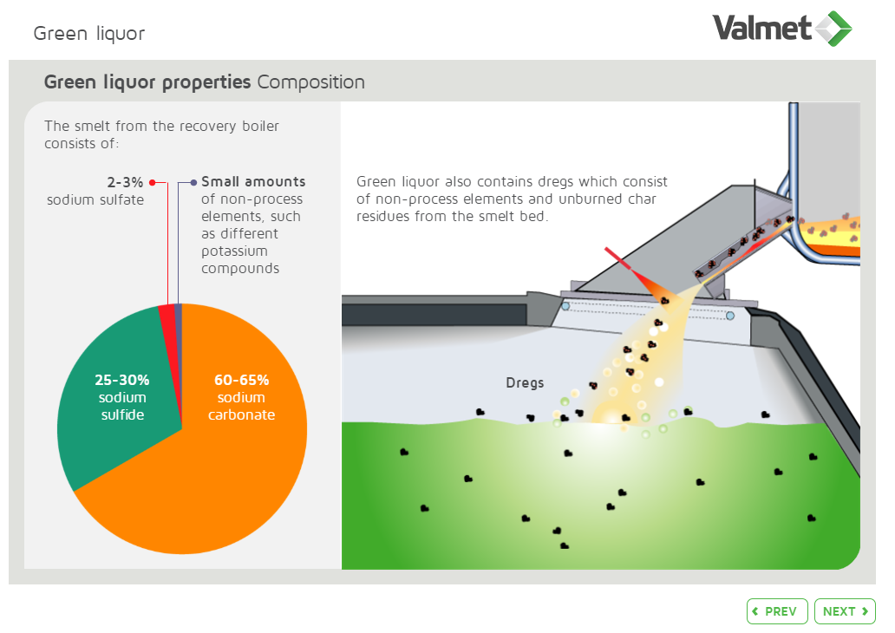
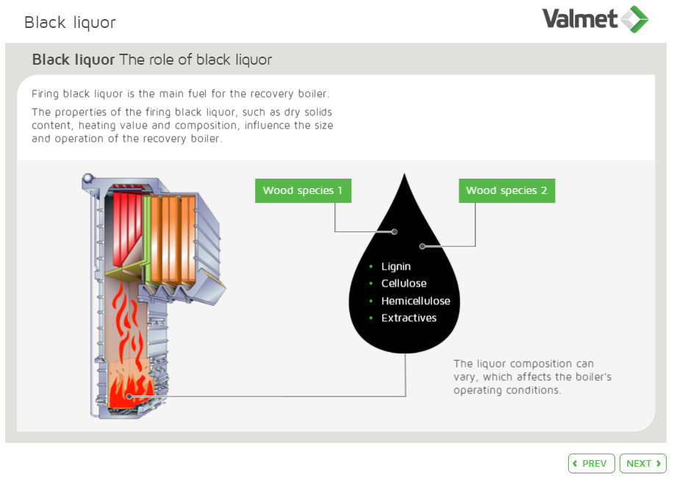
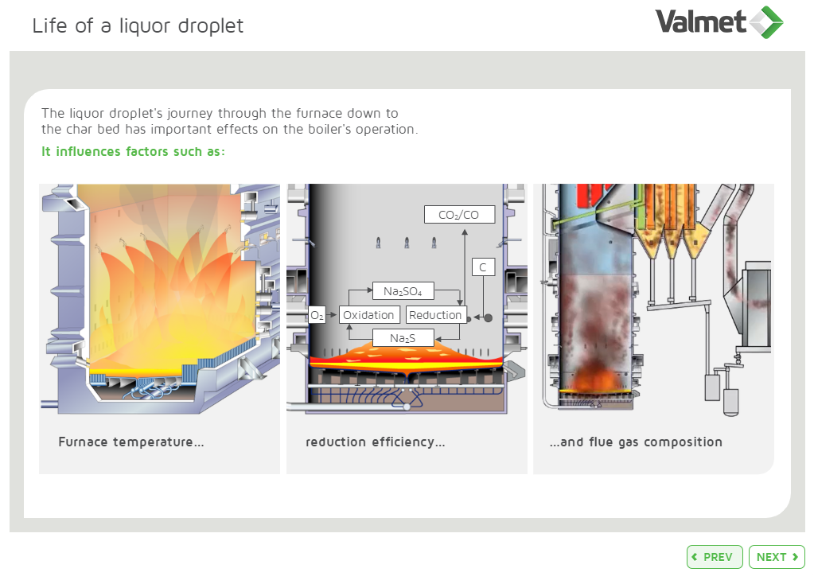
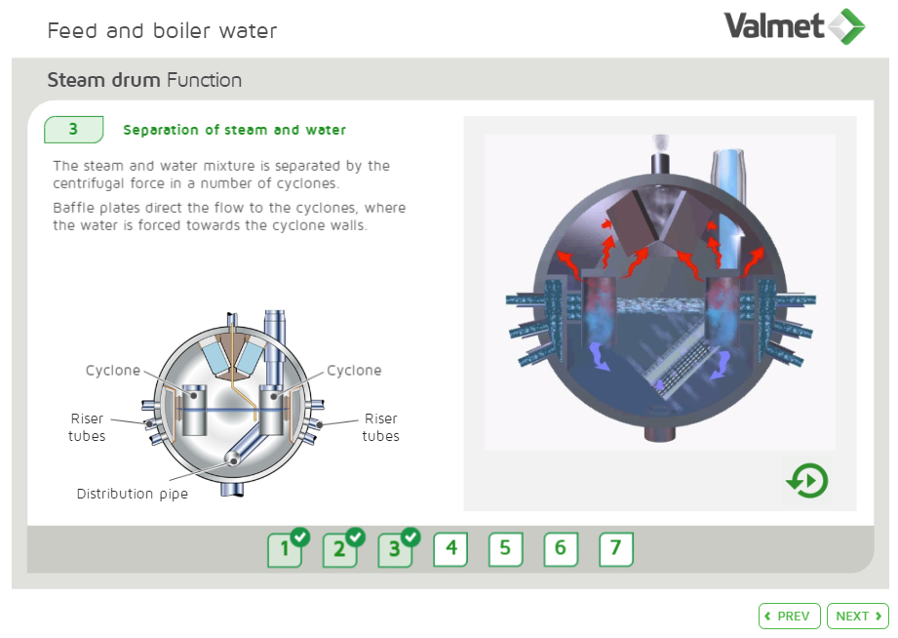
Recovery boiler online course
Divided into Systems & Processes – with Exercises & Quizzes!
Extensive training with 31 modules and finalizing quiz. Describes the purpose, function and design of the components. Involves learning the chemical reactions that take place during liquor combustion, and their preconditions
Notes:
Intro with The recovery boiler's role in pulping
Sections:
Water circulation & steam generation
Combustion air
Black and Green liquor
Combustion & furnace chemistry
NCG, Flue gas & ash
Optimization
Recovery boiler course ‒ Final test

Slide 27
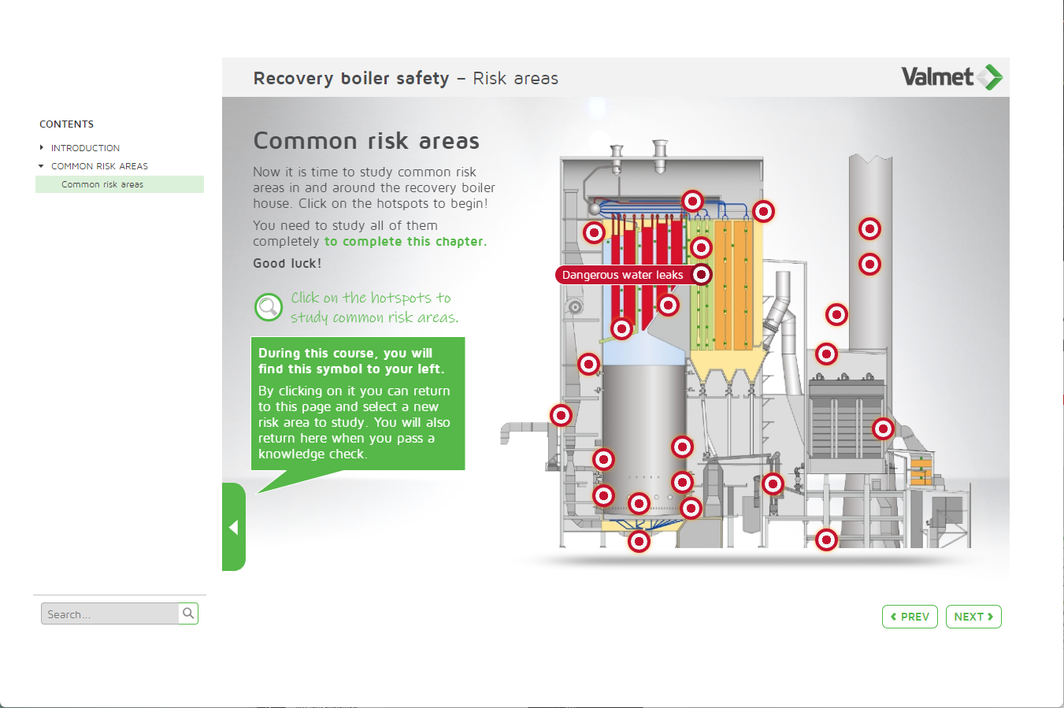
Recovery boiler safety course
Select any risk in any order to study its risk cycle
Request from a pulp mill owner – Insurance company demands operator training. A total of over 20+ different Risk areas were developed to meet their needs, and then described according to the risk cycle; Cause of condition, Consequences of the conditions, Actions to solve the issue, and lastly Preventive safety measures to avoid further risks.
Notes:
List of the Risk areas (opens)
Water leaks
Black liquour system and liquour guns
Risks related to smelt
Weak and strong gases
Inadequate water quality
Mix tank
ESPs
Compressed air
Working at Elevated heights
Confined spaces
Fuel, combustion and flue gases
Working at elevated heights
Safety valves
Tubes, pipes, valves and dampers
Conveyors
Pneumatic actuator
Compressed air
Sootblowers
Electrical equipment
Firing liquor system and liquor guns
Weak and strong gases
Burners
Air ports
Mix tank
Risks related to smelt
Confined spaces
Steam drum
Superheater
Water leakage
Inadequate water treatment
Risky environment
Toxic, acidic or alkaline substances

Slide 28
Recovery boiler safety course
Learn about the causes, consequences, solutions and more for most boiler risks
Dangerous waterleaks
Intro
Consequences
Action list
In detail
Preventive measures
Knowledge check

Slide 29
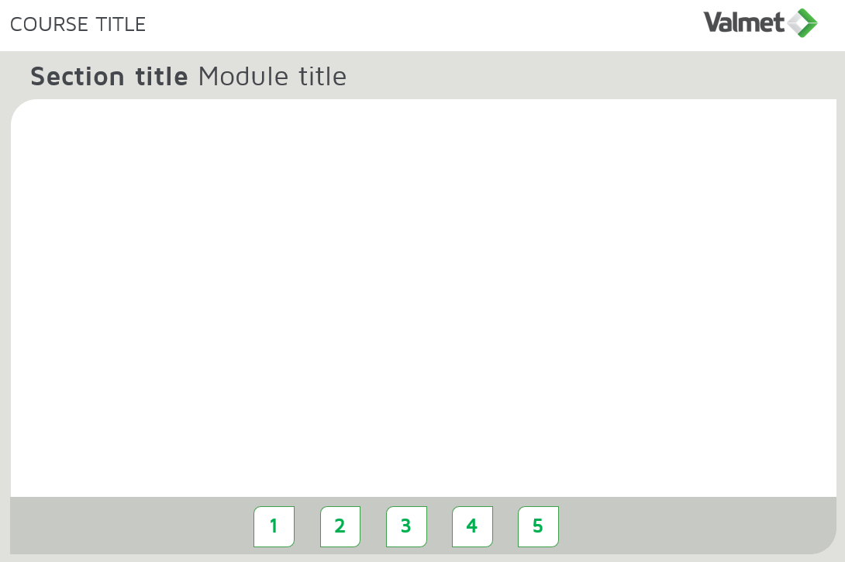
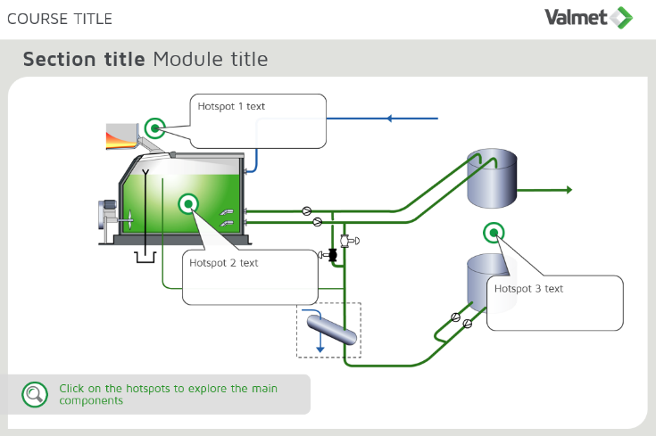
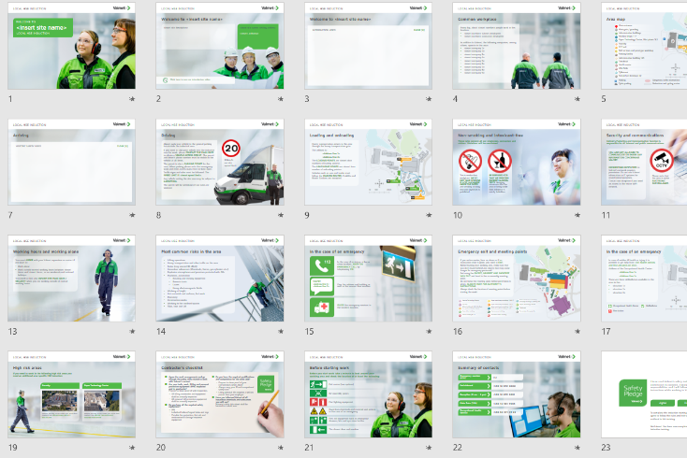
MyPlant explained
Training material for customized content
Design with Your own company logos & colors
Course template created by Valmet
Content provided by customer
Course development by Valmet
Extra material Any other/external material not included in the course like links, PDFs and manuals can be uploaded too
Storage capacity 2 GB will be available for storage for files

Slide 30
Recovery boiler Reference simulator
Practical training based on scenarios
Valmet Training Reference simulator
RB Standard scenarios
Built according to the following data
Based and built according to a typical plant in boiler design and operating modes – with DNA interface. Realistic behavior and simulation exercises matching those of a characteristic Recovery boiler.
On-site training 9 days Start up with Valmet Expert, explaining the process and operation while using the reference simulator as a dynamic training tool.
Filling boiler
Preparing the green liquor system
Purge
Start oil firing
Pressure increase and fluegas cooling
Start green liquor system, ventgas and chemical system
BMS
Black liquor firing
DNCG & CNCG firing
Full production
Sootblowing
Normal / Emergency shutdown
Rapid drain
Black liquor load: 2300 ton DS/day
Steam flow: 320 ton/h
Steam pressure: 98 bar(g)
Steam temperature: 480 C
6 start burners
2 pressurized black liquor tanks
Fluegas cooling
ESP

Slide 31
Future training
Do not add text here
Do not add text here

Slide 32
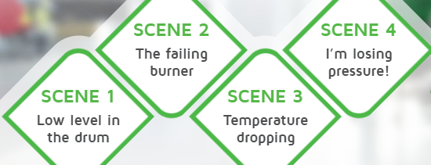
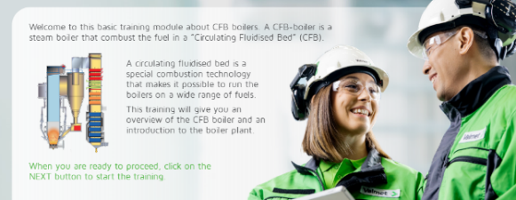
From basic to advanced Online courses at all competence levels
The learning curve continues after start-up
Advanced certification of experienced operators after start-up
Operator certification before start-up (Example: power boiler operators)
Optimizing the operation
Operating the plant
Getting to know the plant
3
GOLD
2
SILVER
1
BRONZE

Slide 33
Recovery boiler Optimization course
Advanced topics & trouble shooting
The course will contain advanced topics & trouble shooting, how to optimize and how the systems correlate, together with advanced quizzes.
Black liquor and ash composition
Black liquor spraying (temperature & pressure)
Life of a liquor droplet
Furnace chemistry
Lower furnace combustion operation and consequences on availability and reduction efficiency
Upper furnace combustion – over fire air
Deposits in upper furnace
Heat transfer and steam generation
Optimization of operation
Production economy
Obtaining a low O2 level to reduce NOx and fan energy consumption cost
Water analysis and sootblowing optimization
Launch Next year

Slide 34
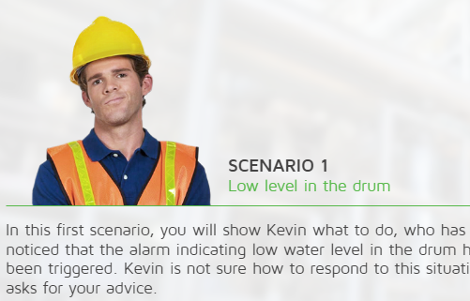
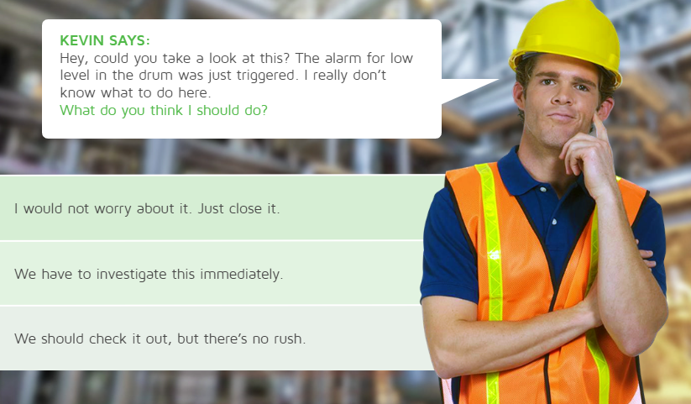
Scenario training
Practice managing various disturbance scenarios in the Recovery boiler with the help of a coach
Scenarios being:
Low drum level
Low O2 level in the flue gas
The dry solids content of the black liquor drops during operation
Coach says:
I will be with you all along to help and support you.

Slide 35
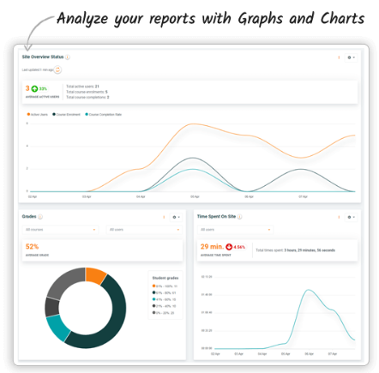
Detailed and Customized reports
Operator spent X minutes in a course, quiz in X minutes / grades / completion / Login dates

Slide 36
Create RB VR environment for Safety training
Planning – Future training in the mill?
Tube leakage scenario
Get info from the operator room
Walking in the mill
Answer quizzes and content
Collect equipment and clothes
Motivation and engagement

Slide 37
Do not add text here
Customer references
Do not add text here

Slide 38
Customer references
Latest training agreements with Valmet Online Learning
Customer | Country | Agreement | Courses
3 pulp mills | Sweden | 5+ years agreement | 16 online courses Mill wide
Pulp mill | Poland | 5-year agreement | RB, RB safety, Evaporation, Recaustization, Lime kiln
Pulp mill | Germany | 3-year agreement | 15 online courses Mill wide
Pulp mill | Portugal | 3-year agreement | Recovery, RB safety, RB competence mapping
Pulp mill | Finland | 2-year agreement | 10 online courses Mill wide
3 pulp mills | Portugal | 3-year agreement | Recovery line, 8 courses
Pulp mill | Chile | 5-year agreement | RB, RB safety, BFB boiler, Pulp drying & Baling

Slide 39
What do the customers say?
Valmet Online Learning
I am impressed by the quality and scope of the courses, there is a lot of work behind!
Production manager, German mill
Thanks for this, and its great…
I think you guys have done a fantastic job with this eLearning platform!
Head of South African Pulp mill
We want to provide all of our recovery boiler operators, both the experienced operators, as well as the less experienced operators, with the best prerequisites and skills to deliver excellent performances. Since Valmet also includes safety aspects in their online training, we decided that this was a superb addition for our operators’ regular (internal and external) training agenda.
Plant Manager, Swedish mill
After a demo of Valmet training tools, the customer told us we were “light years” ahead…
Sales manager, UK
I've logged in on Valmet Online Learning platform and I'm positively surprised with the technical content and also with the interface of your LMS! Such a great work you've done there!
Process engineer, Brazilian mill
The whole training program is a good investment over time – A couple of avoided unplanned production stops give a fast payoff. Engineer, Swedish Power boiler plant
No technical errors. No errors in voice over. Visuals (Figures, Animation, videos) are excellent & outstanding.
Tappi Pulp and Paper organization in US
Impressive! I think we could really benefit from this we need to make it fit with the training material we have put together (MyPlant), and I like the fact that this is online self-learning and platform gives good status feedback and progress of each employee's commitment and progress.
Head of Continuous Improvement, German Paper mill
I received really good feedback in regards to ease of use, the material is useful, and a great resource to enhance knowledge of fundamentals.
Training & Development Manager, US mill

Slide 40
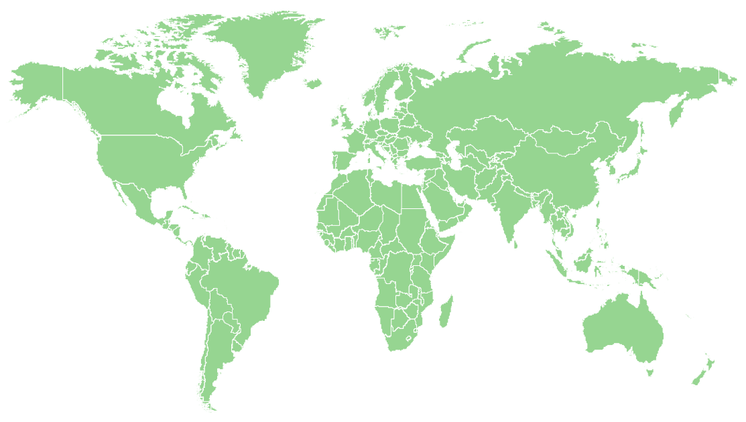
References
Valmet Online Learning
Billerudkorsnäs Gruvön
Billerudkorsnäs Skärblacka
Bomhus Energi
Jönköping Energi
Kalmar Energi
Karlskrona Energi
Mälarenergi
Mölndalenergi
Rottneros Vallvik
SCA Lilla Edet
SCA Obbola
SCA Östrand
Smurfit Kappa Piteå
Stora Enso Skoghall
Stora Enso Skutskär
Stora Enso Fors
Södra Cell Mönsterås
Södra Cell Mörrum
Södra Cell Värö
Vattenfall Jordbro
Värmevärden Nynäshamn
Övik Energi
Metsä Husum
Södra Cell Tofte
Fortum Naantali
Kilpilahti Power plant
UPM Kymi
Metsä Kemi
Pori Energia
Pulp/paper mill
Power plant
Mill wide
Other
Hofor
Örsted
UPM Shotton
Eon Lockerbie
Ilim Bratsk
April Rizhao
Hainan Mill
Oji Nantong
ITC Bhadrachalam
Nine dragons
Bac Ninh
Karawang
HH Dunaújváros
Mondi Swiecie
DS Smith Viana
Norske skog Bruck
Stora Enso Langerbrugge
Braunschweig
2valorise Ham
Mercer Rosenthal
Altri group
Getec
Wee Energies
Weyerhaeuser Kingsport
GRU Gainesville
Riau Andalan
Arauco Nueva Aldea
Arauco MAPA
CMPC Guaiba
CMPC Laja
Eldorado

Slide 41
Do not add text here
Thank you for listening.
Questions?
Do not add text here

