Slide 1
Bodman SERVICES LLC
a subsidiary of RMR Mechanical
boilercleaningdoctor.com OR bodmanservices.com

Slide 2
Bodman SERVICES LLC
Bodman Services LLC formed in September 2021
Purchased from George H. Bodman Inc. after Mr. Bodman passed away
George H. Bodman Inc. formed in 1991
Focused primarily on chemically cleaning Paper mill boilers
Also perform chemical cleaning in refineries, chemical plants and utility plants
Same Technical Advisors

Slide 3
Technical Advisors
Service Background & Experience
Michael Bayse Chemical Engineer 44 years
Mark Sargent Marine Engineer/Corporate 47 years
Gene Cotton Chemist - Entergy 50 years plus
Susan Childress Water Treatment Engineer 40 years plus
Brook Holland Chemical/Pulp&Paper Engineer 27 years
Mike Daignault Chemical Cleaning Supervisor 40 years
Bodman Services LLC
Office: 770-205-9646 OR 1-800-286-6069
FAX: 770-205-9580
Web: bodmanservices.com

Slide 4
When to Chemically Clean a Recovery Boiler
After a significant feedwater system event; black liquor incursion, pH excursion (especially a significant low pH event), raw water incursion, etc.
When DWD’s have risen above boiler OEM threshold levels
- below 1000 psi – 20-40 g/ft²
- 1000-2000 psi – 12-20 g/ft²
US BLRBAC recommends chemically cleaning based on two criteria:
- time based criteria; typically 5-10 years
AND
- data based criteria (DWD/Deposit analysis)
Most major paper companies in the US are time based, the majority not exceeding 10 years between cleaning recovery boilers
Many times, tube samples do not reflect or are not taken from the dirtiest locations in the boiler
Many locations do not like to take tube samples in the lower composite furnace areas – likely the highest heat release area of the boiler

Slide 5
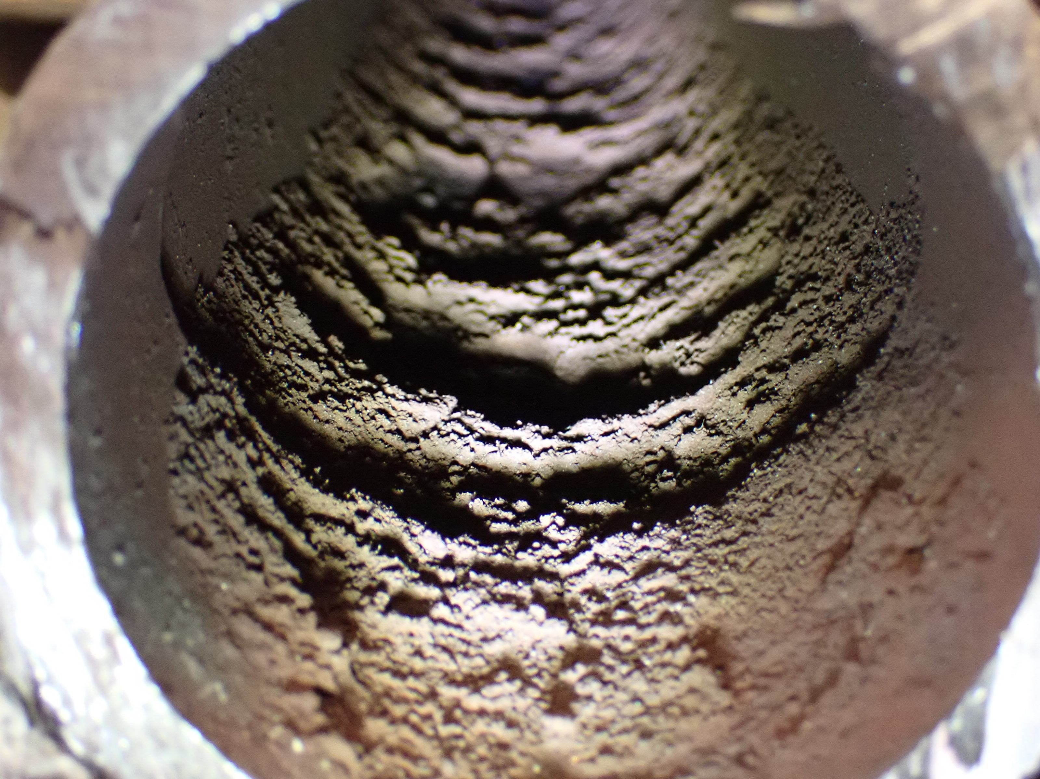
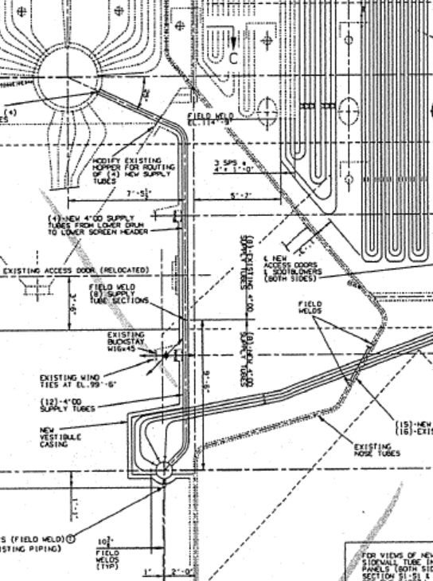
Rear wall tube below nose arch
Found after videoprobing
Lower durnace had been NDE examined for deposits a few months earlier during annual outage - did not find these deposits 100+ g/ft²
Tube failed here
Videopobing found deposits here

Slide 6
BOILER CHEMICAL CLEANING CONSULTING SERVICES
Execution
Safety
Pre-Engineering
Chemical Cleaning Guidelines
Chemical Cleaning Contractor
On-Site Preparation
Oversee Chemical Cleaning Process
Inspection and Flushing Plan
Magnetite Formation and Start-Up Assistance
Technical Advisors
Other Contractors – Boilermakers, Pipefitters

Slide 7
Pre-engineering
Prerequisites
Drawings
Boiler side view elevation drawing
Boiler feedwater and steam P&ID drawings
Steam and mud drum internals drawings
Downcomer, upper and lower water wall header drawings
Upper headers riser tube drawings
Screen tubes and headers drawings, supply pipe arrangement drawings
Economizer arrangement drawings
Superheater arrangement drawings
Walk down boiler with operations

Slide 8
Pre-engineering
Prerequisites
Volumes
Boiler, Superheater, Screen tubes, Economizers
Deposit Weight Analysis
All recent DWD analysis
Tube sample to analyze is desired
Water treatment vendor reports
Chemical cleaning history
Recent pressure part failure reports
Outage Schedule
Safety Training to Allow Unescorted Access

Slide 9
Pre-engineering
Planning
Determine chemical cleaning circuits
Determine hot and cold water supply and steam supply (if needed) to manifold
Determine tie-in points to boiler proper for optimum deposit removal
Develop chemical cleaning manifold drawing (Attachment 1)
Ability to perform dissolution testing on tube samples to ensure cleaning methods will be successful
Mechanical Scope
Permanent and temporary piping requirements
Interface with your mechanical/boiler/piping contractors

Slide 10
Pre-engineering
Mechanical Scope (continued)
Identify valves, fittings, flange covers, etc.
Identify inspection and flushing points including handhole caps needed for removal
Steam and mud drum modifications needed for optimum deposit removal
Develop chemical cleaning procedure/guidelines
- chemical requirements for chemical cleaning contractor
- safety and environmental concerns
- step by step cleaning procedure
- schedule and timing
- RFQ document

Slide 11
SAFETY
We believe that Safety is paramount in any chemical cleaning. We follow the “TCC” concept on all our projects.
“Teamwork” – plant personnel, chemical cleaning contractor, Bodman Services LLC personnel, water treatment company personnel, others all work together as a team.
“Communications” – Bodman Services LLC personnel lead a team safety “JSA” talk every 12 hours to discuss: “where we are, where we have been and where are we going” for the oncoming shift – safety is always the 1st topic discussed
“Continuity” – clear communications at shift change, maintain same team on day and night shift

Slide 12
PLANNING
Planning
Valve position requirements
Identify needed hot and cold water sources, flows and requirements
Development of a post acid clean inspection plan and supervision
Development of a post acid clean flushing plan and supervision
Development of magnetite formation and start-up procedure and supervision
Procedures approved by client and chemical cleaning contractor/sub-contractors
Collaboration between mill outage planning personnel, contractors and Bodman Services LLC personnel to avoid overlap and minimize impact of chemical cleaning on outage duration

Slide 13
ON-SITE ACTIVITIES
Bodman Services LLC personnel on-site 2-3 days in advance of chemical cleaning
- assure mechanical integrity
- assure chemical inventory and strength approved
- boiler isolated, ready for chemical cleaning
- boiler closed up to retain heat necessary for proper deposit removal
- boiler valved properly to accept chemicals
- contingency planning completed for potential scenarios and all parties prepped and prepared
- boiler boundary identified and flagged off

Slide 14
CLEANING EXECUTION
Bodman Services Technical Advisors Role
Oversight of chemical cleaning contractor to assure all cleaning steps are followed following the detailed cleaning procedure
Closely follow all steps to assure proper temperatures and chemical concentrations are maintained
Boiler walk downs routinely completed at every step of the procedure
Assists operations personnel with critical instrument and drain flushing
Observe chemical cleaning contractors on temporary piping and valving to assure optimum flows and circulation methods are being followed
Interprets all chemical solvent testing to assure deposit removal
Keeps chemical cleaning contractor on schedule and look for opportunities to save time on critical path

Slide 15
POST CHEMICAL CLEANING
Observe handhole removal
Inspection of all drums and headers must be considered
Tube/header inspection by videoprobing/visual observation must be considered
Modifications to flushing plan based on inspection results must be considered
Unique start-up procedure to minimize magnetite formation time and avoid re-deposition of iron prior to releasing boiler to produce steam for the plant

Slide 16
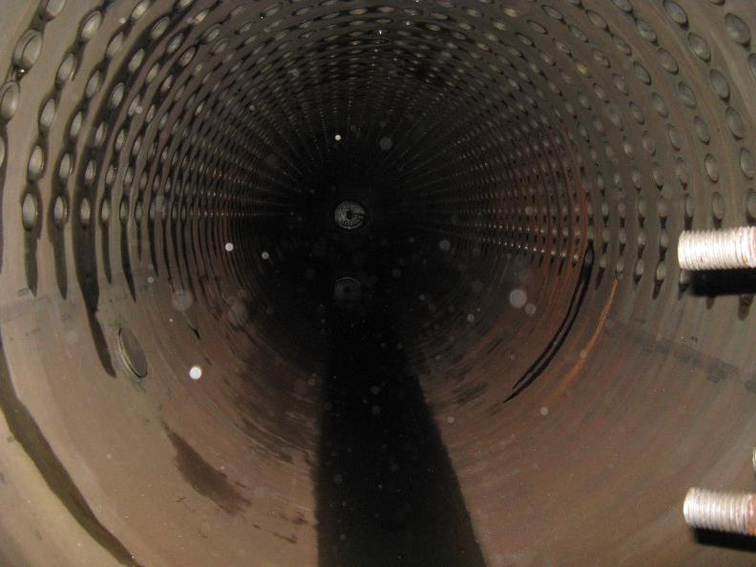
RESULTS
Mud drum opened after passivation – no sludge and well passivated using our unique chemical cleaning procedures (results vary based on how dirty the boiler might be and boiler design)

Slide 17
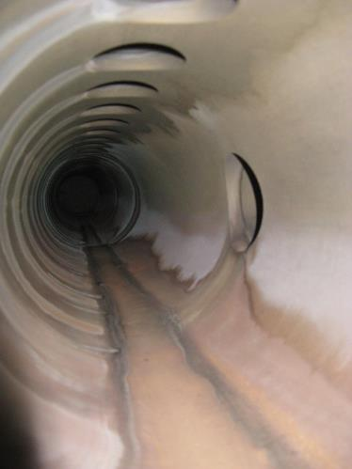
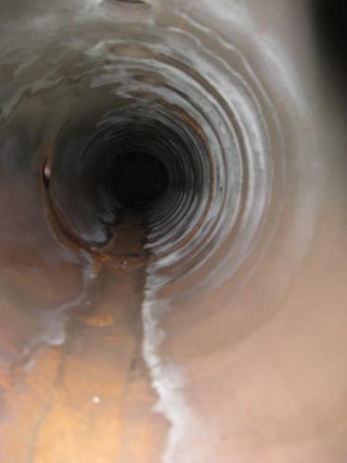
RESULTS
Lower water wall headers BEFORE flushing – no sludge and well passivated using our unique chemical cleaning procedures

Slide 18
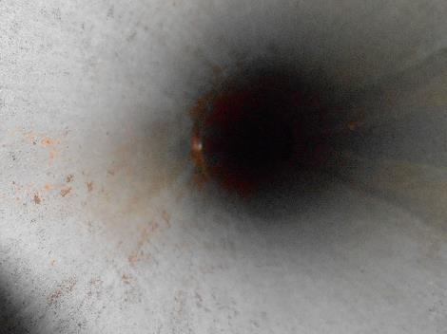
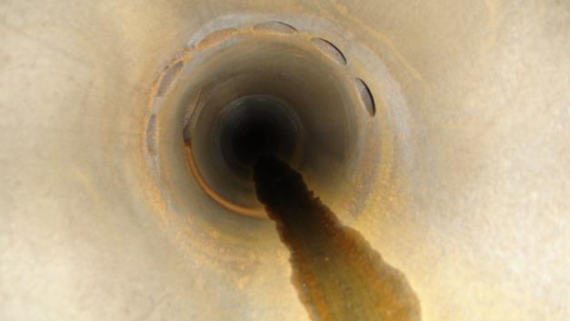
RESULTS
Lower screen tube headers BEFORE flushing – no sludge and well passivated using our unique chemical cleaning procedures

Slide 19
KEYS TO MINIMIZING CHEMICAL CLEANING DURATION
Large connections on lower water wall headers
Large connections on lower screen headers
Large vent (can only fill and drain the boiler as fast as you can vent air when filling and allowing air in when draining)
Ample hot and cold water supply – need the proper flow and temperature to fill the boiler in less than 2 hours (one hour is preferred)
We anticipate filling and draining boilers 6-10 times each – depends on how many chemical stages
Most common cause of chemical cleaning delays is lack of adequate water supply !!
Existing 1.5” lower header drains are NOT adequate for quickly filling and draining the boiler !!

Slide 20
EXPERIENCE
We have cleaned many boilers with screen tubes
Cleaning screen tubes correctly is important
The method used to circulate and clean screen tubes was 1st designed and performed by us after a screen tube failure
Prior to us changing chemical cleaning methods (circulation) most all consultants, including us, used a “soak and surge” method to clean boilers – not as effective – lots of leftover sludge to deal with – most importantly screen tubes
Generally speaking – most all boilers we clean with our recommended connections and circulation methods with have very little or NO sludge remaining in lower headers and screen tubes – saves time in flushing and inspection !!

Slide 21
POST CHEMICAL CLEAN
We recommend flushing tubes/headers post chemical clean
We recommend videoprobe inspection post flushing to ensure all/most sludge has been removed
We recommend a start-up magnetite formation procedure be followed to form magnetite early on boiler start-up after chemical cleaning
Bodman Services Technical Advisors can produce the flushing/inspection/magnetite formation procedures and can supervise these activities for your team

Slide 22
Attachment 1
LOWER SCREEN HEADER
Feedwater
Supply
Diffuser
3” lines
Demin water
4-6” line to the common downcomer, ground floor
Symbol for check valve
Relief
Valve
Set at
150 psi
3” line to
5th floor
PI
TI
6” Manifold
Flow Meter
by CCC
2” chemical line from CCC
½” sample
line
Blind
Flange
Heat Exchanger by CCC
Circ pump
by CCC
Flow
Meter
by CCC
½” sample
line
chemical line from CCC
To Frac Tanks
To Sewer
60 psi steam

Slide 23
Vapor Phase Cleaning
Cost effective way to clean new boiler tubes prior to installation
Can clean individual generating bank and wall tubes/panels
Can clean superheater pendants that are non-drainable
Minimizes impact to outage schedule as the cleaning is done prior to the start of the outage
Degrease and mill scale removal with complete chemical cleaning and degreasing operation
Removes preservatives and desiccants that have been applied by fabricator
Minimizes waste generated for cleaning

Slide 24
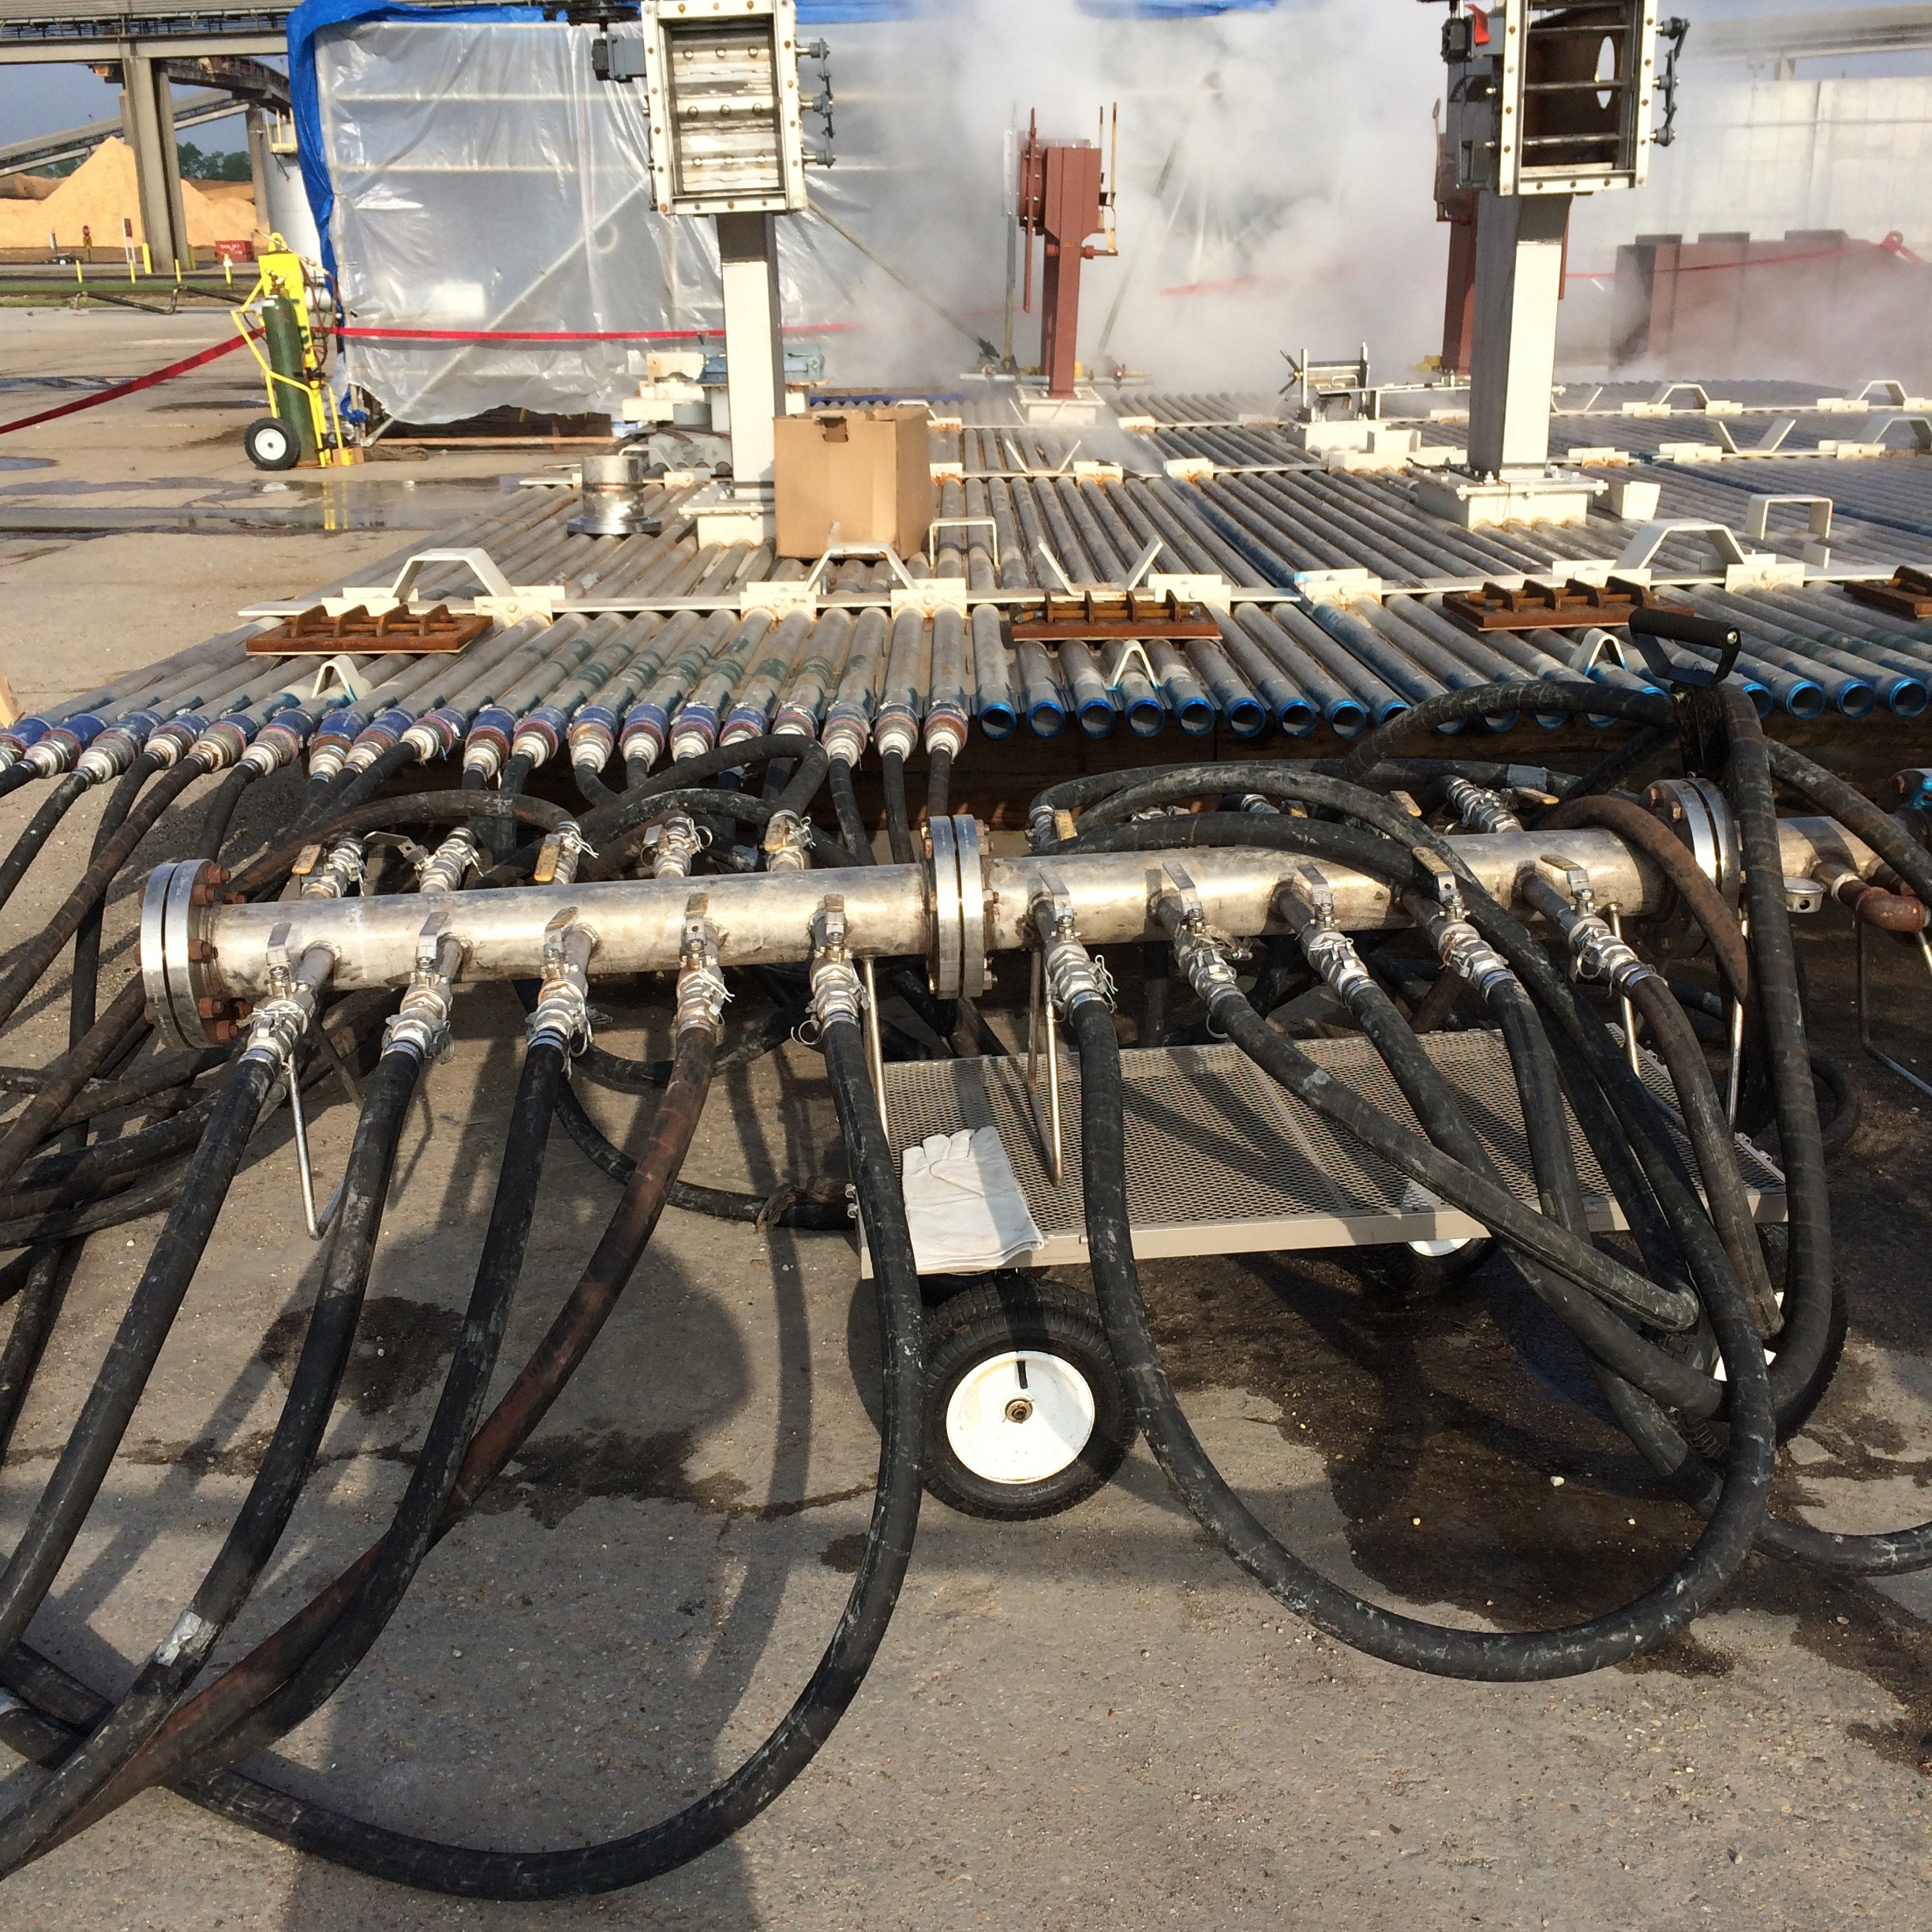
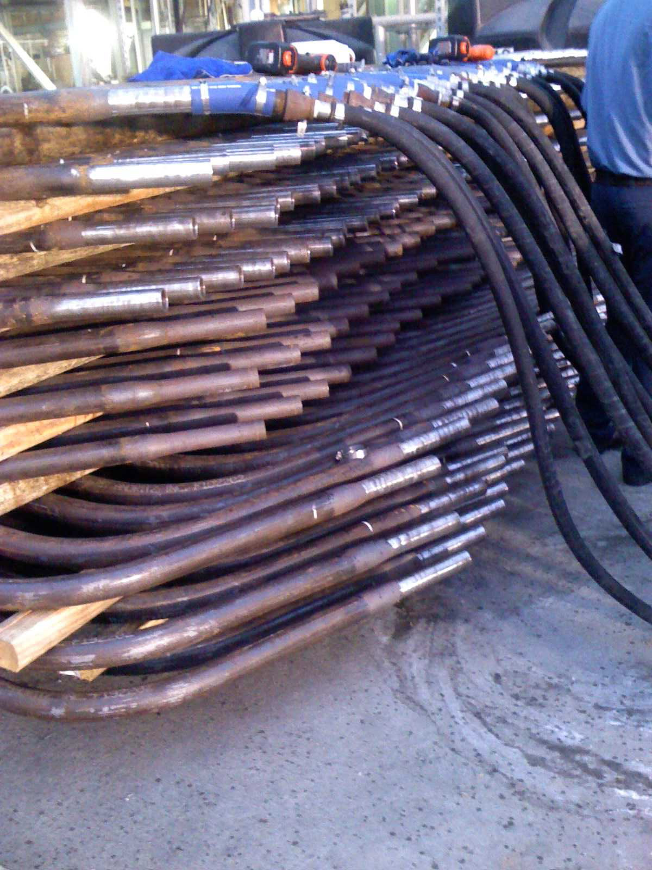
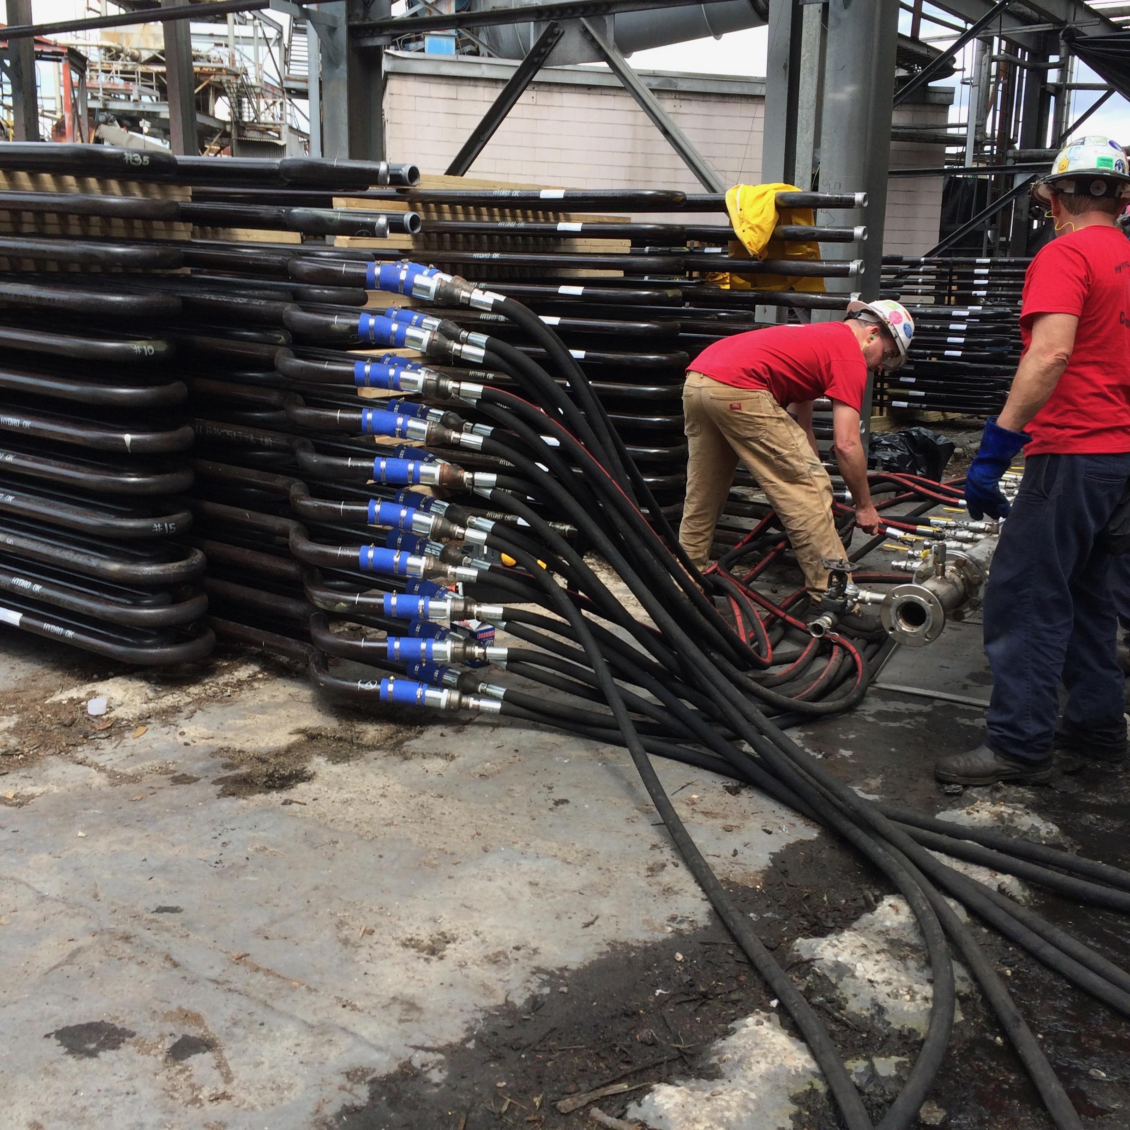
Vapor phase operation
Photos from vapor phase cleaning a side wall panel, generating bank tubes and superheater pendants

Slide 25
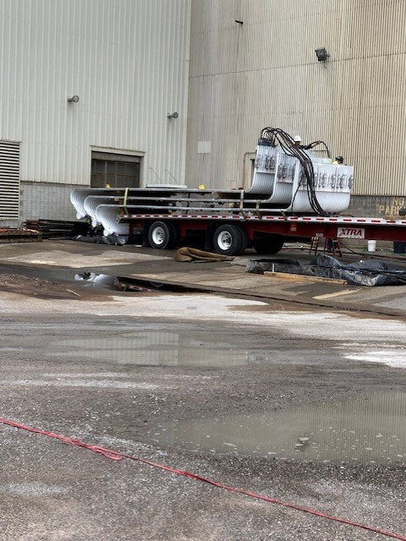
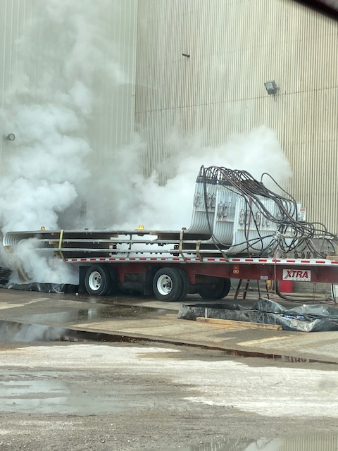
Vapor phase operation
Photos from vapor phase cleaning three floor panels prior to installation

Slide 26
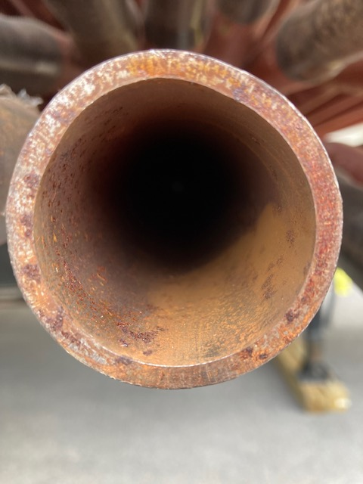
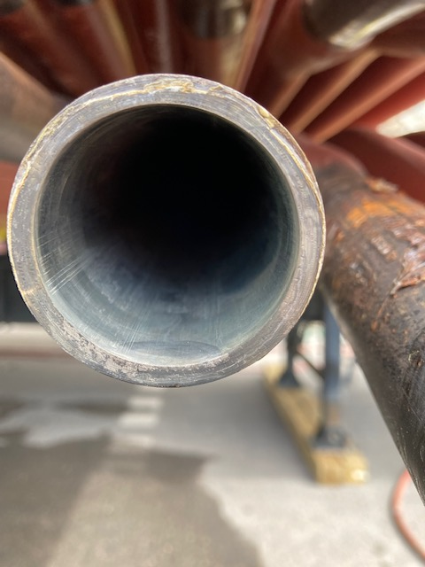
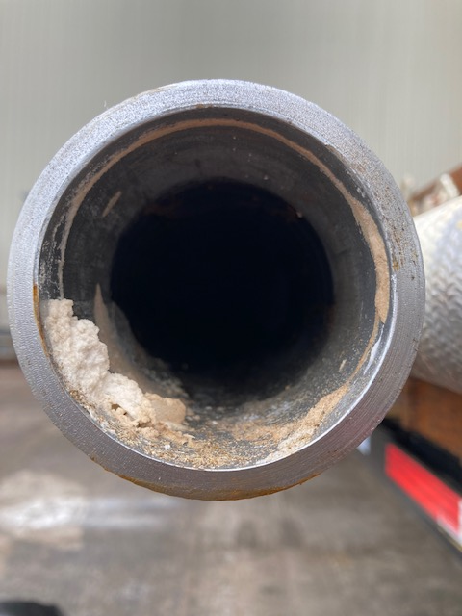
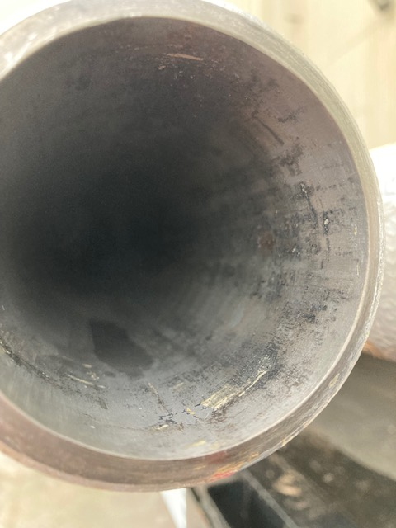
RESULTS
Photos before and after vapor phase cleaning – first 2 photos are generating bank tubes and the second two are tubes in a side wall panel

Slide 27
Technical Advisors
UNMATCHED experience in the boiler chemical cleaning industry
Over 200 years of chemical cleaning experience
Chemical Engineers
Corporate Engineers
Operating Engineers
(2) personnel with over 65 combined years of recovery boiler operating experience
Interface with plant personnel, working with water treatment company, boiler contractors and chemical cleaning contractors
We know and understand boilers – WE HAVE OPERATED THEM, HELPED DESIGN THEM AND HAVE MORE EXPERIENCE CLEANING THEM THAN ANYBODY IN THIS BUSINESS – ASK OUR REFERENCES

